Slide 1

RAGHU ENGINEERING COLLEGE
(AUTONOMOUS)
DEPARTMENT OF EEE
Academic year: 2018-2019
II year 2-semister
Digital Electronics
CASE STUDY
ON
Design Of 3 Bit Majority Circuit With Cost Analysis.
FACULTY:
Mr.D.Bhaskar Rao
Associate professor
BATCH-3
18985A0246 – K.Karthik
18985A0247 – L.Ratnakara Rao
18985A0248 – M.Gaddim Naidu
18985A0249 – M.Jagapathi varma
18985A0250 – M.Sai

Slide 2
Design Task
To design a 3 bit majority logic circuit.

Slide 3
Design Restrictions
3 input ranges between 0 to 7 then only considering majority bits in every term ,leaving minority bits .
Design Goal
To design cost affective circuit by examining popular realizations with comparing with different IC’s and its manufacturing specifications.

Slide 4
Design options
Input A | Input B | Input C | Output Y
0 | 0 | 0 | 0
0 | 0 | 1 | 0
0 | 1 | 0 | 0
0 | 1 | 1 | 1
1 | 0 | 0 | 0
1 | 0 | 1 | 1
1 | 1 | 0 | 1
1 | 1 | 1 | 1
As we all know we got 4 types of
realization, namely:
SOP Realization.
POS Realization.
NAND Realization.
NOR Realization.

Slide 5
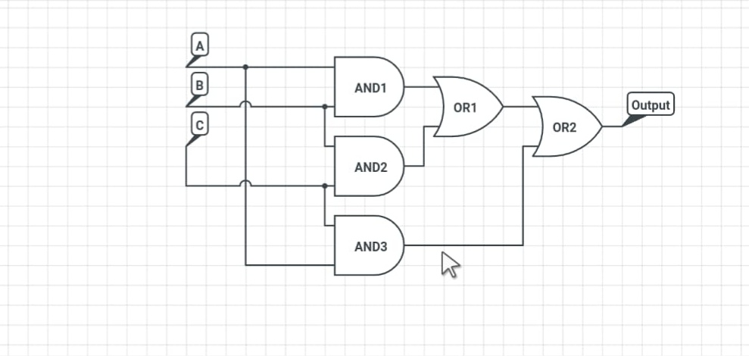
SOP Realization

Slide 6
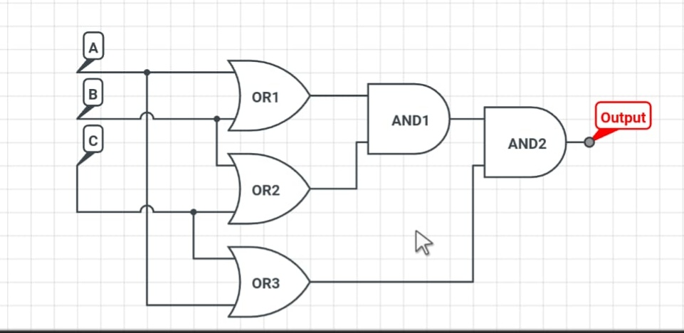
POS Realization

Slide 7
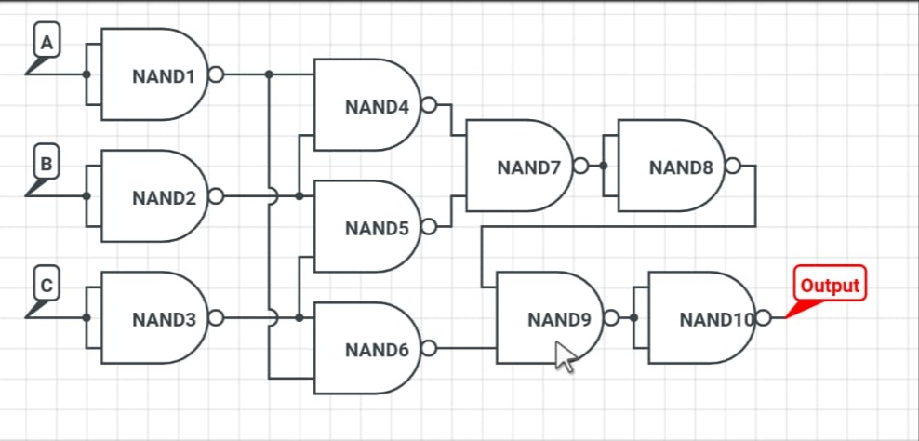
NAND Realization

Slide 8
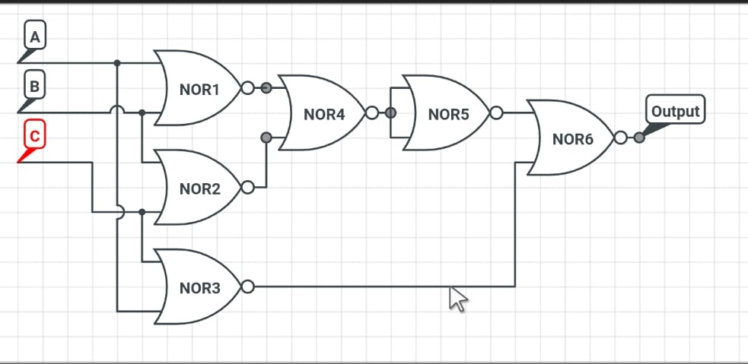
NOR Realization

Slide 9
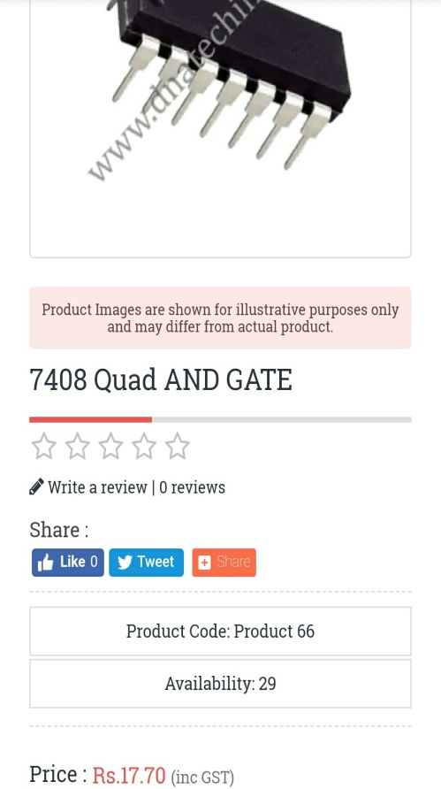
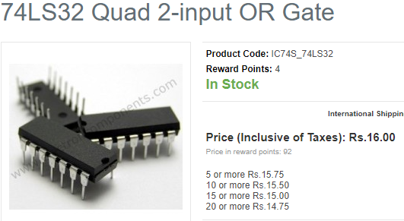
Cost Analysis
Cost analysis of SOP gate
IC No. | Cost per IC | IC’S required | Total Cost | Final Cost
74LS08 | Rs.16 | 1 | Rs.16 | Rs.16
74LS032 | Rs.17.70 | 1 | Rs.17.70 | Rs.17.70
 |  |  |  | Rs.33.7

Slide 10
Cost Analysis
Cost analysis of POS realization
IC No. | Cost per IC | IC’S required | Total Cost | Final Cost
74LS08 | Rs.16 | 1 | Rs.16 | Rs.16
74LS032 | Rs.17.70 | 1 | Rs.17.70 | Rs.17.70
 |  |  |  | Rs.33.7
Table 2: POS cost assessment.

Slide 11
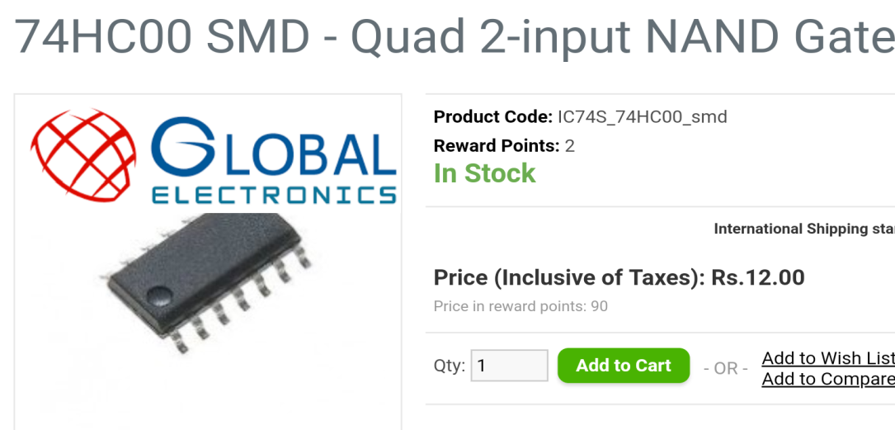
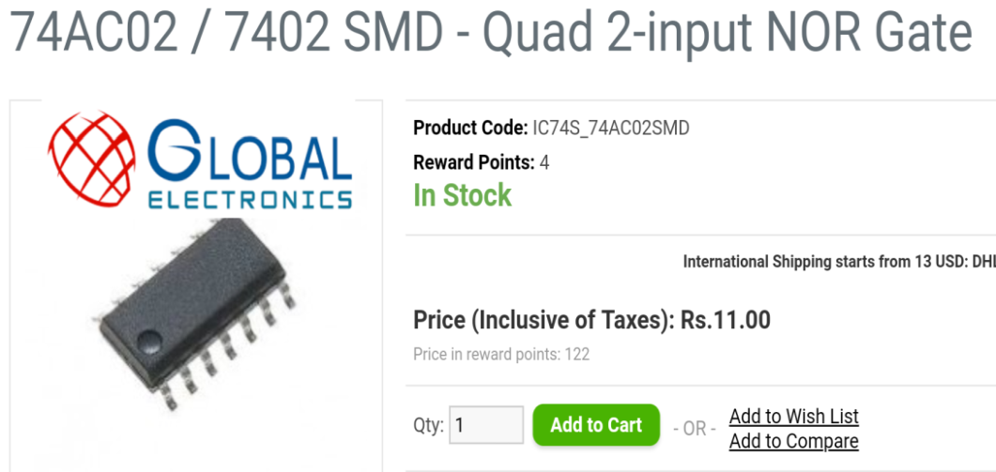
Cost Analysis
Cost of NAND Realization
Cost of NOR Realization
IC No. | Cost per IC | IC’S required | Total Cost | Final Cost
74LS00 | Rs.12 | 3 | Rs.36 | Rs.36
IC No. | Cost per IC | IC’S required | Total Cost | Final Cost
74LS02 | Rs.11 | 2 | Rs..22 | Rs.22
Table 5: NOR cost assessment.

Slide 12
Cost Effective Realization
Comparing the above cost assessments we came to conclusion that NOR realization is more affective in terms of cost.
IC No. | Cost per IC | IC’S required | Total Cost | Final Cost
74LS02 | Rs.11 | 2 | Rs..22 | Rs.22

Slide 13
Design Failure Analysis
Sno. | Realization | No. of IC’s required | Highest probability of failure
1. | SOP realization | 2 | NAND realization Gates required is "3"
2. | POS realization | 2
3. | NAND realization | 3
4. | NOR realization | 2
Table 6: failure analysis

Slide 14
CONCLUSION. .
All the realizations have been designed and verified in Software and finally the cost affective realization has been implemented in hardware with NOR realization

Slide 15
THANK YOU

